Slide 1
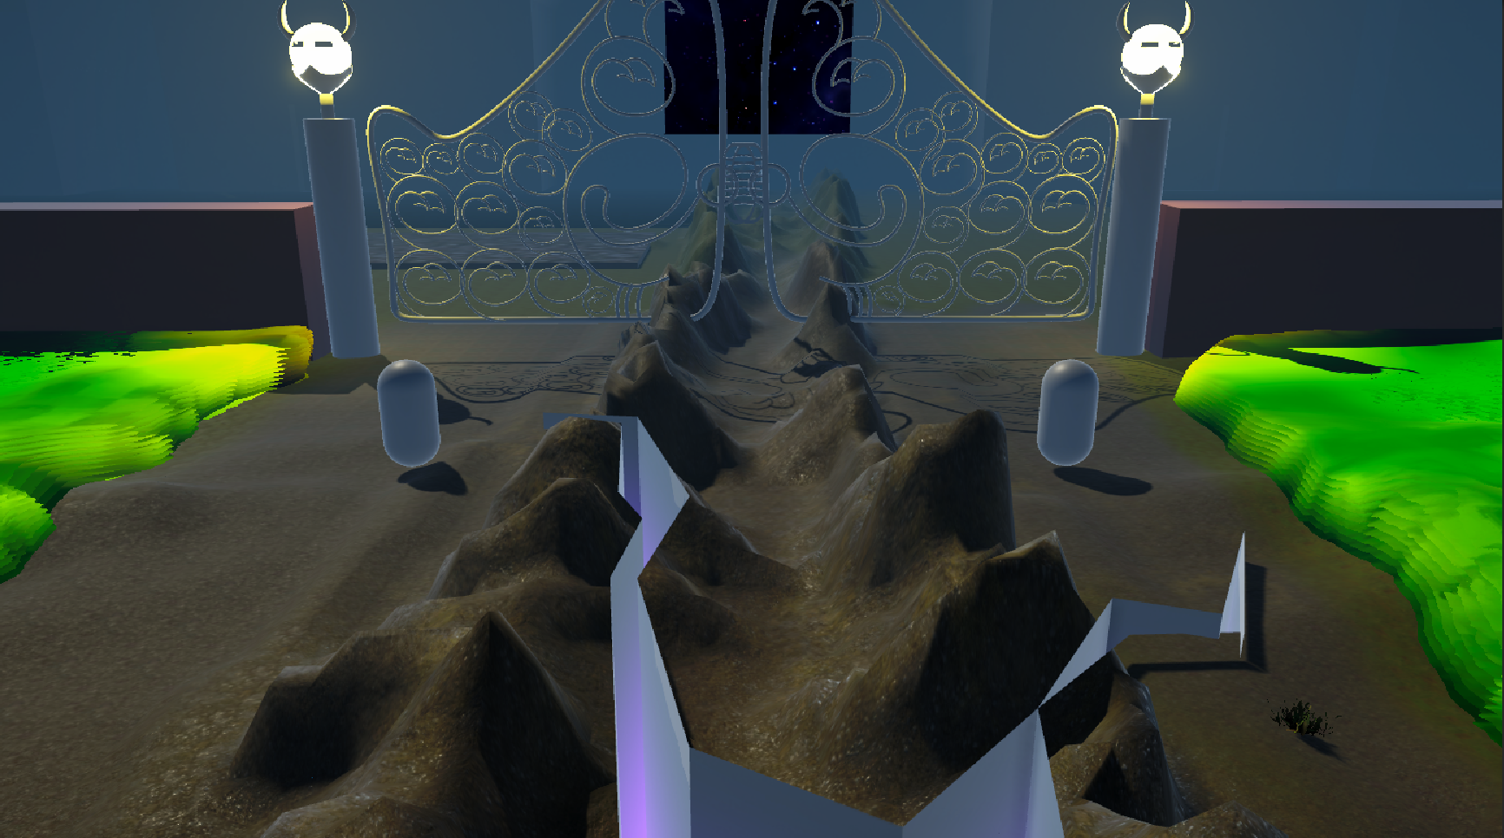
Planet of Twins
Planet of Twins
*Visual does not represent the final product
Duality shattered, bond starts to fade , defy the odds or watch your world fall

Slide 2
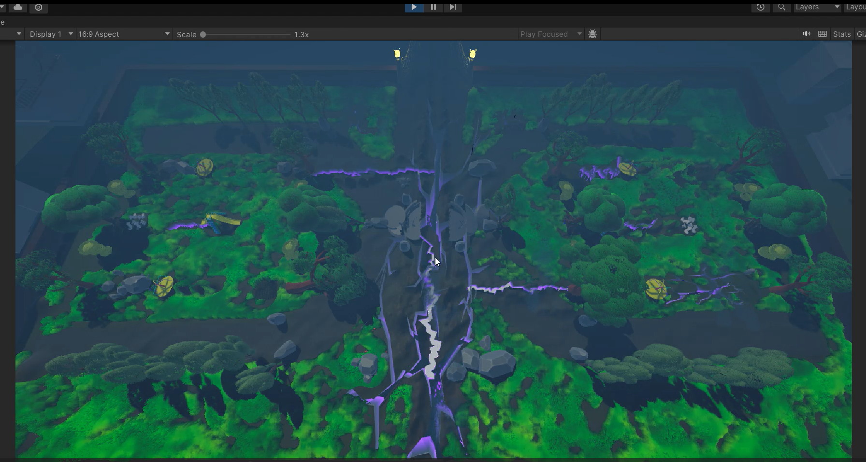
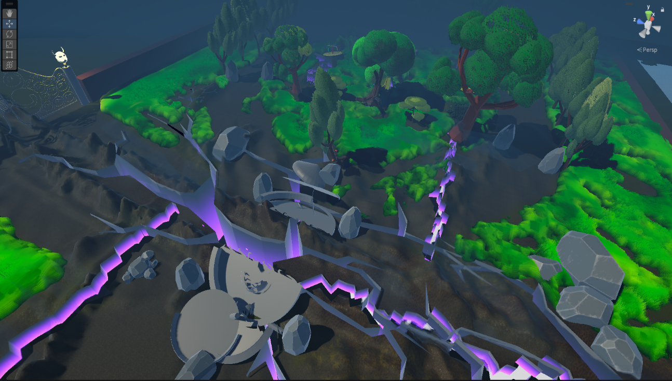
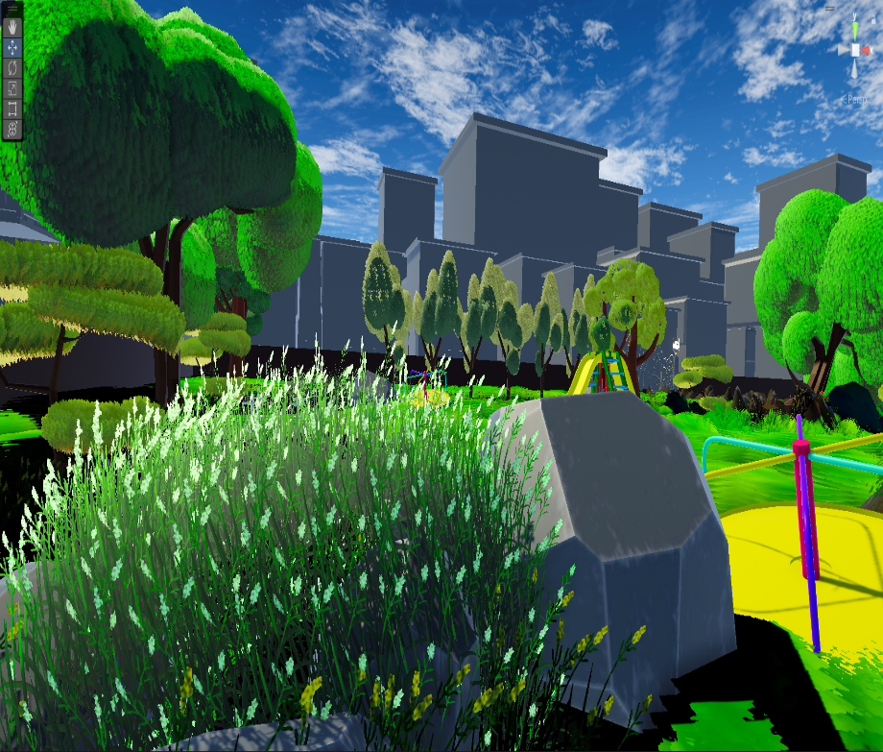
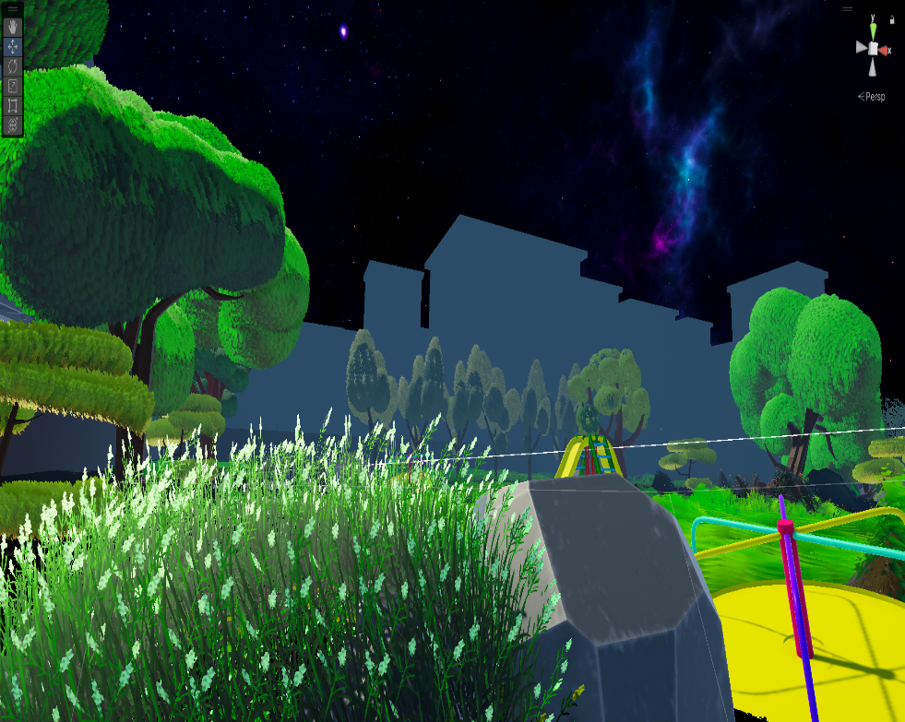
Planet of Twins is a Cooperative adventure game filled with different puzzles forged in a 3D world. It offers a unique character controlling system that players have to utilize to solve the challenges in their path.
Power of their bond combined with their gifts from their clan to restore balance in their planet
Mode – Single player
Genre – 3D Puzzle, Adventure, Cooperative
Target Device – PC | Consoles
Target Audience – 18+ Adventure, puzzle gamers
Game engine – Unity
Price - $10 USD (36.6K copies approx)

Slide 3
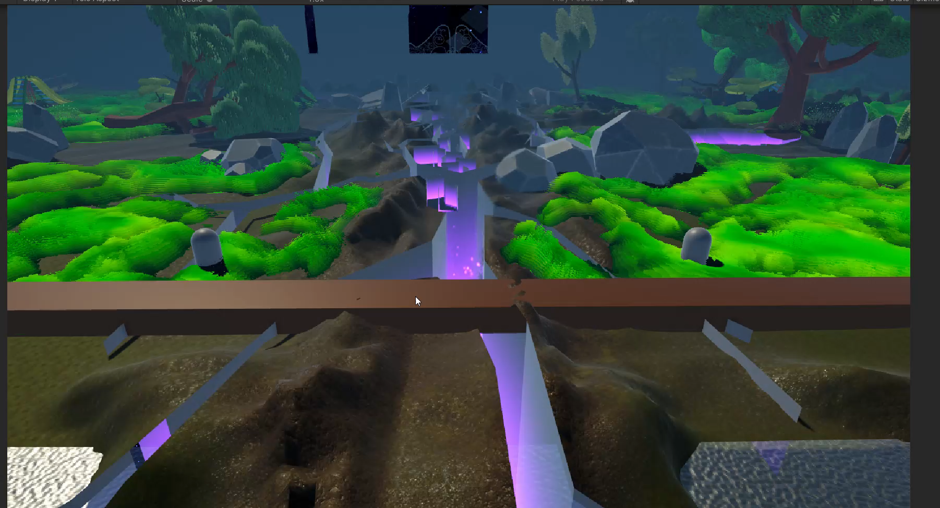
Unique Player Controls –
A unique way to control the characters
Both characters reach together to advance in the level
Keeps player attentive to the surroundings

Slide 4
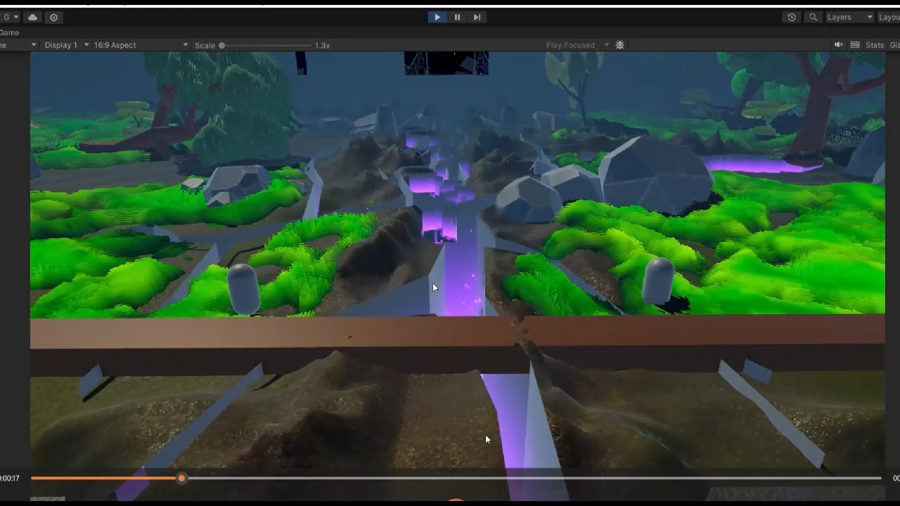
Challenging Health system –
A Unique health system for characters
The further the distance between the character, the less their health is.
Keeps players on lookout for ways to solve the puzzle by being at the minimum risk.

Slide 5
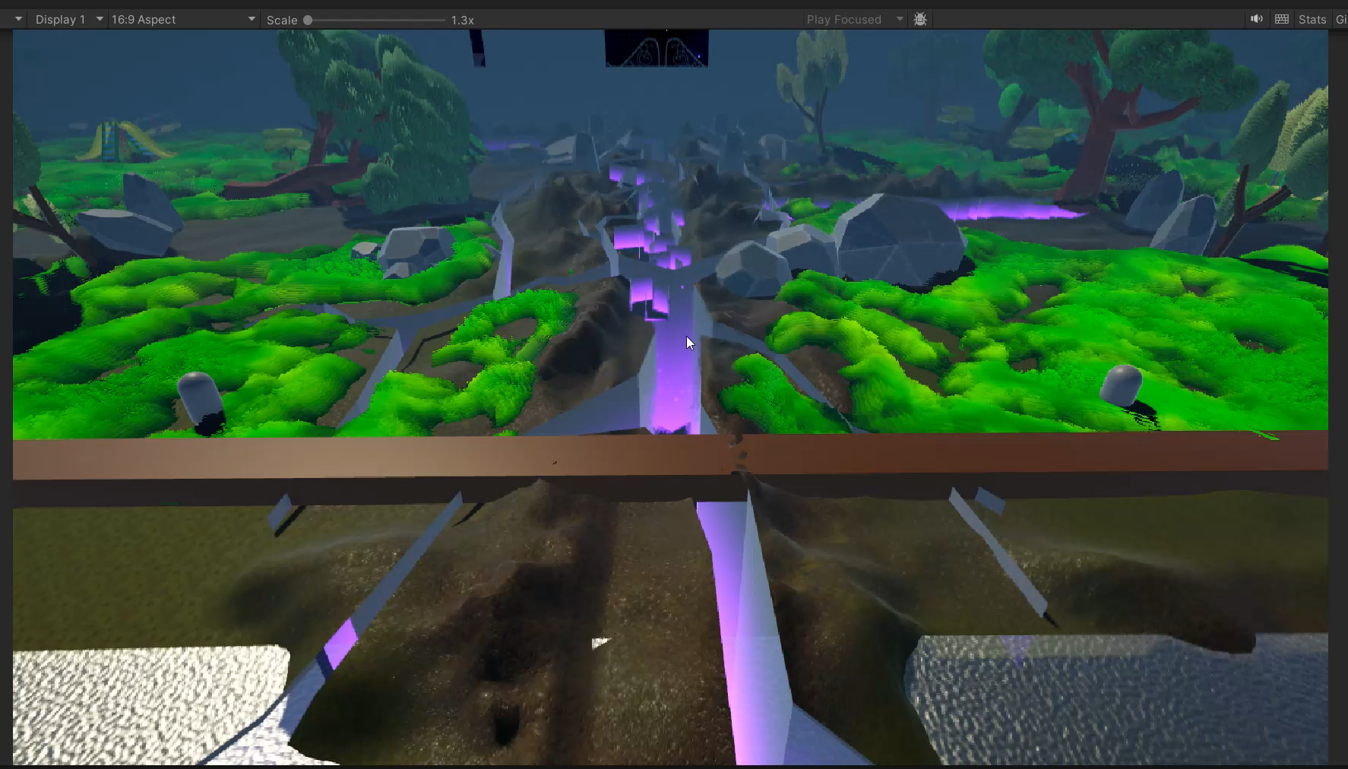
Weaver’s Gate –
This allows characters to teleport their soul to the other side and help them out of danger or trap.
When in danger the life of the characters will start dwindling, that’s when ability can be activated.
Activation only available at the time of danger (Initially)
*Video does not represent final product

Slide 6

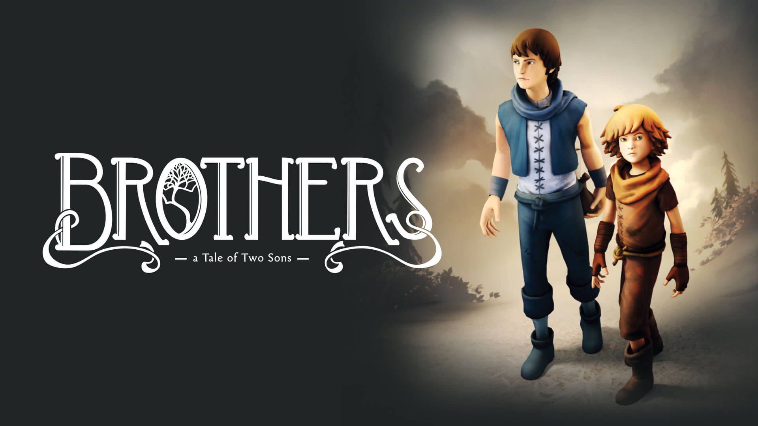

THE MARKET
While there are was not any direct game with similar control scheme but there were few games with dual character control in the puzzle and adventure genre that are quite popular in the market. Due to popularity of games like it takes two, little nightmares and Brothers, There is significant potential for planet of twins too in the market.

Slide 7
DEVELOPMENT PLAN
Development plan for the project planet of twins.
There will be a demo version available for free
Based on feedback the game will be finalized and released.

Slide 8
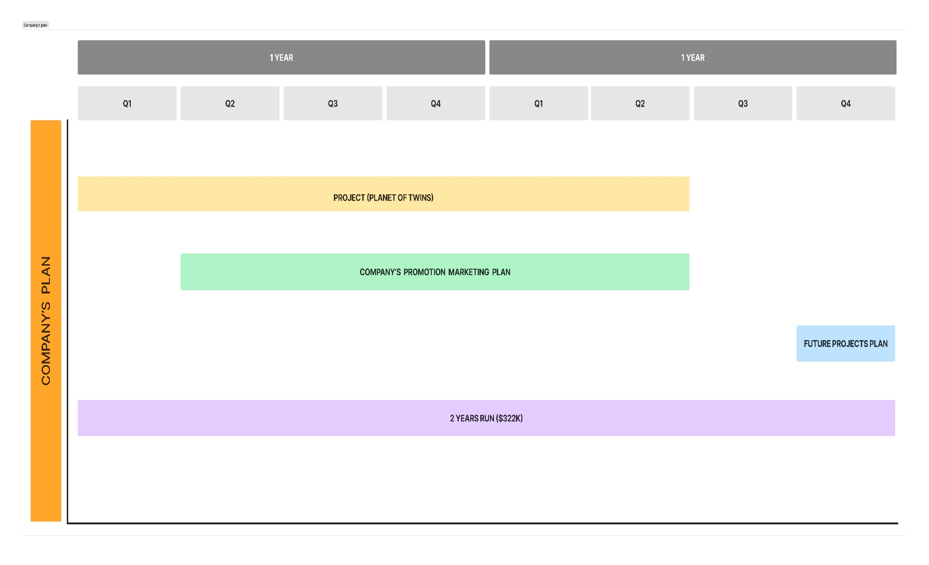
The Company’s Roadmap
Planet of twins will be presented as company’s face product
Company’s promotion marketing plan will be devised to make presence in the industry through small side projects or snippets of main project

Slide 9
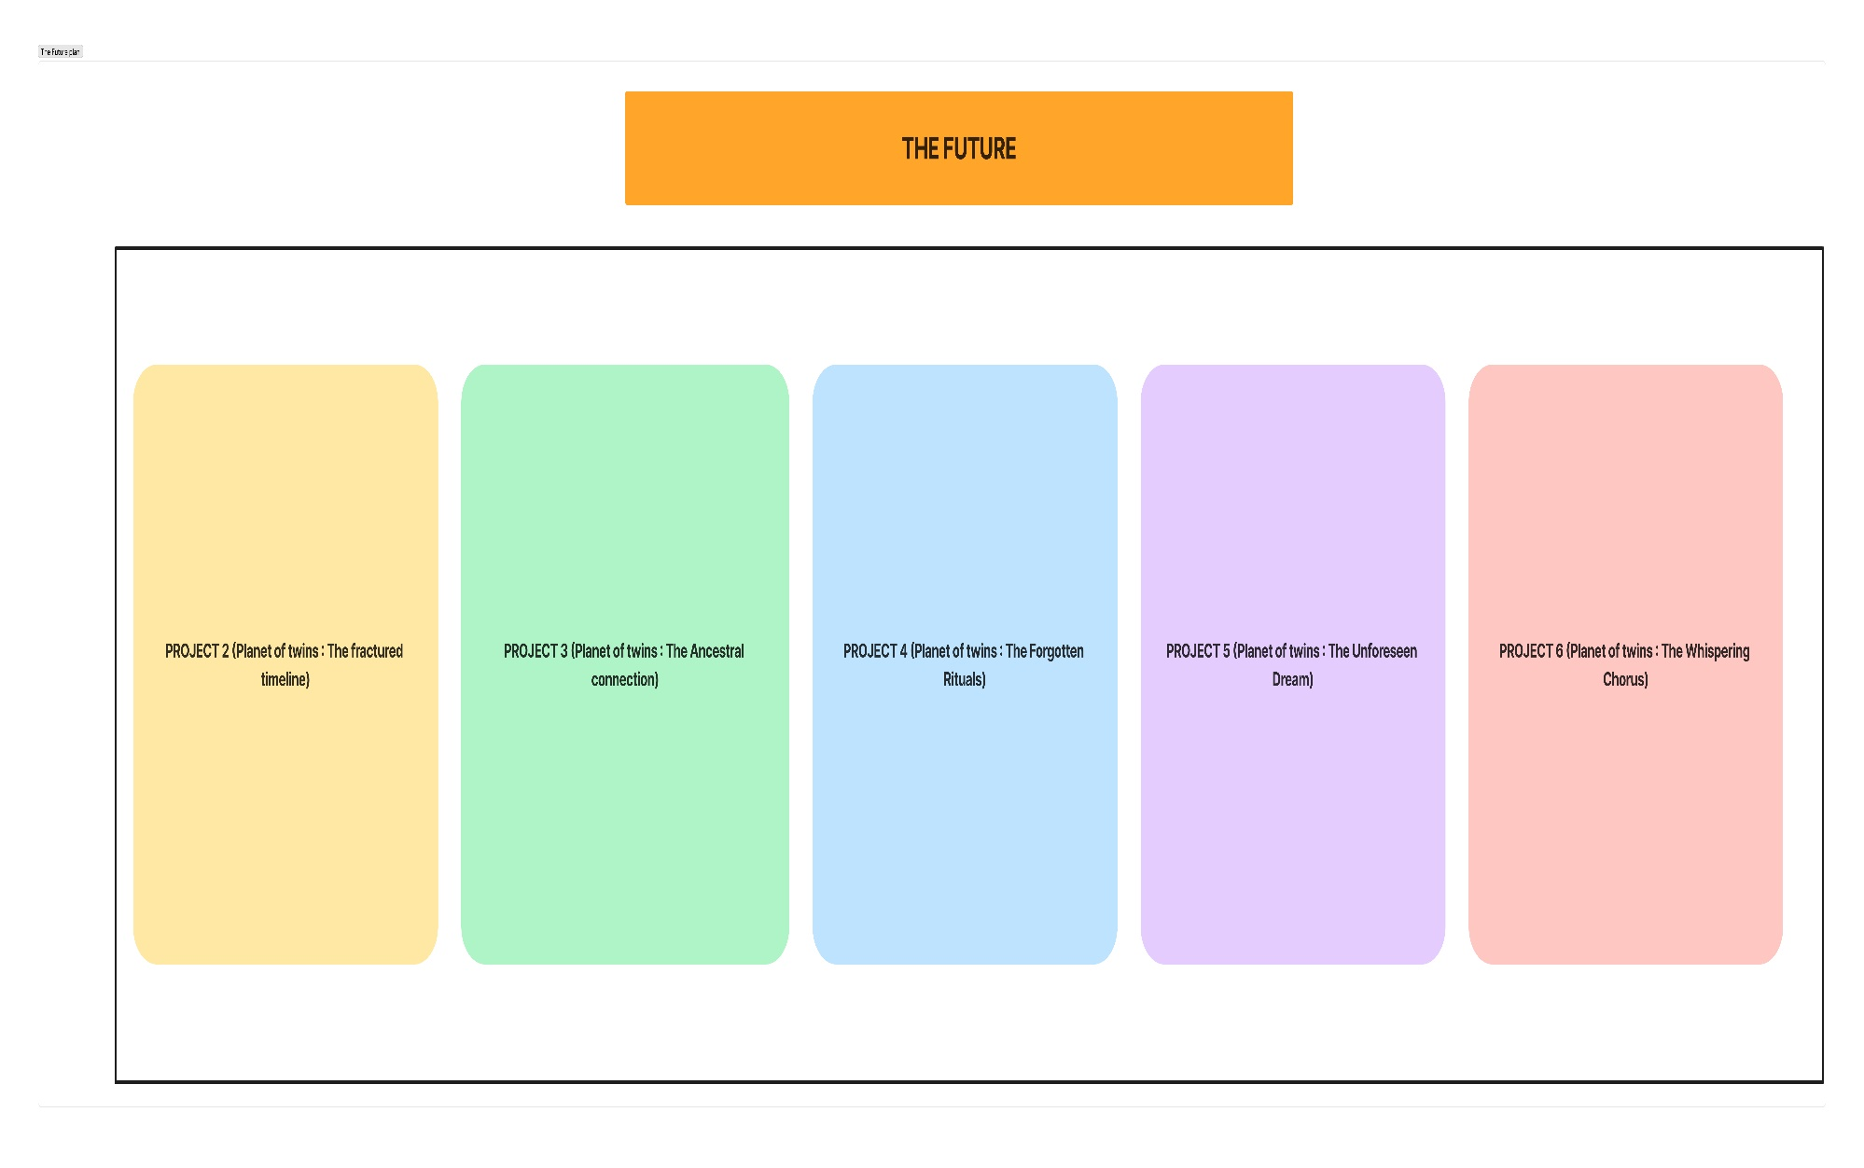
Future Project Plans
Future plans includes different projects. The project will help in storyline and character progression.
Protagonists will be unveiling the story in 6 iterations. Each gives them new powers and also enhances their control on the existing ones
There journey will consist many curves that reveals why all this happened and who was behind it. It will be up to them to find the root and restore peace.

Slide 10
ASK $350K(USD)
This will help us to release the planet of twins within a period of 1 year and 6 months.
We will also be making short multiplayer games to create a presence in the market and company’s portfolio before the main projects launch.
This will help us to allocate and withhold resources for a run of 2 years.
The total team size would be (6 Dev, 2 Audio department, 3 QA and 3 Art and animation )
To regain this funds, We need to sell 36.6K copies of planet of twins (Priced at 10$)

Slide 11
Summary
Planet of Twins is a Cooperative Adventure, puzzle game with a strong storyline and character development. Each iteration of planet of twins develops the character of our protagonists and give them a new purpose to proceed further in their journey
We will require $350k USD to complete this project in 1 year and 6 months and recoup it, We will need to sold 36.6k copies of the game
The total team size would be (6 Dev, 2 Audio department, 3 QA and 3 Art and animation )
We Believe that planet of twins has great potential with strong storyline and character build up along with unique gameplay systems and powers to make it a great success in the gaming world.
THANK YOU SO MUCH

